Slide 1
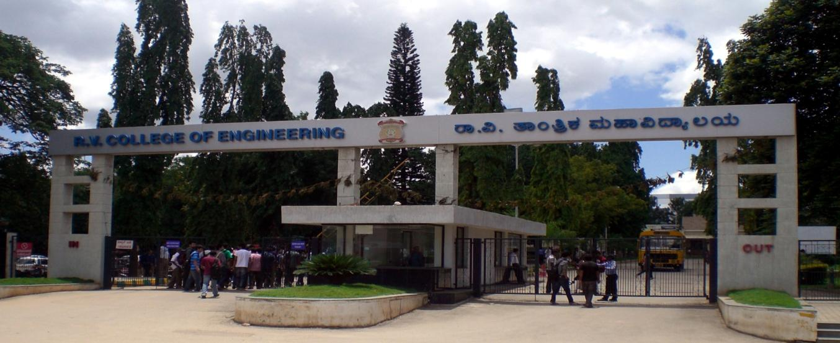
6th Sem Self Study Phase -2 Evaluation
TOPIC
Analysis of text and audio reviews using ML algorithms
NAME USN Ranjith G Hegde 1RV16CS112
Ujwalakavya J 1RV17CS435
Department of Computer Science & Engineering
R V College of Engineering, Bangalore

Slide 2

Presentation Outline
Review of Problem
Use of rapid development tools
Demonstration
Experimental analysis and presentation of result
Future work
References (Recent IEEE/Springer/ACM/Elsevier papers to be referred)

Slide 3
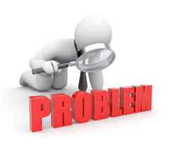
Review Of Problem
In the ever growing market of today customer feedback is very crucial in a company’s survival. The gathering and accurate analysis of data is very hard which is the problem that needs to be solved in the industry.
Customer feedback is an area in the current market which is not much focused on by many companies. So there is a huge scope for growth in this field which can be seized.

Slide 4


Use of Rapid Development Tools
Android Studio
Android Studio is the official integrated development environment, built on JetBrains' IntelliJ IDEA software and designed specifically for Android development.
Eclipse
Eclipse SDK is free and open-source software, used in computer programming, and is the most widely used Java IDE.[
The Eclipse Web Tools Platform(WTP) project provides tools for developing Web and Java EE applications.

Slide 5

Spring Framework
The Spring Framework is an application framework and inversion of control container for the Java platform. The framework's core features provides an extensions for building web applications on top of the Java EE platform.
Stanford CoreNLP
It provides a set of human language technology tools. It gives the base forms of words, their parts of speech, normalize dates, times, and numeric quantities, and syntactic dependencies.

Slide 6
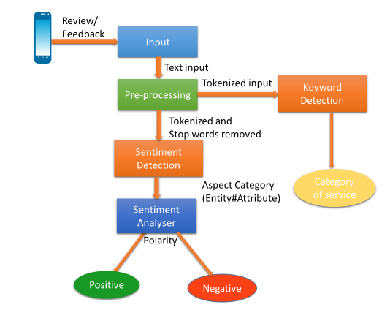
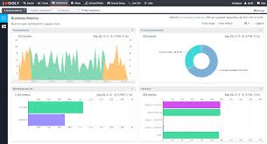
Demonstration
Emotion

Slide 7

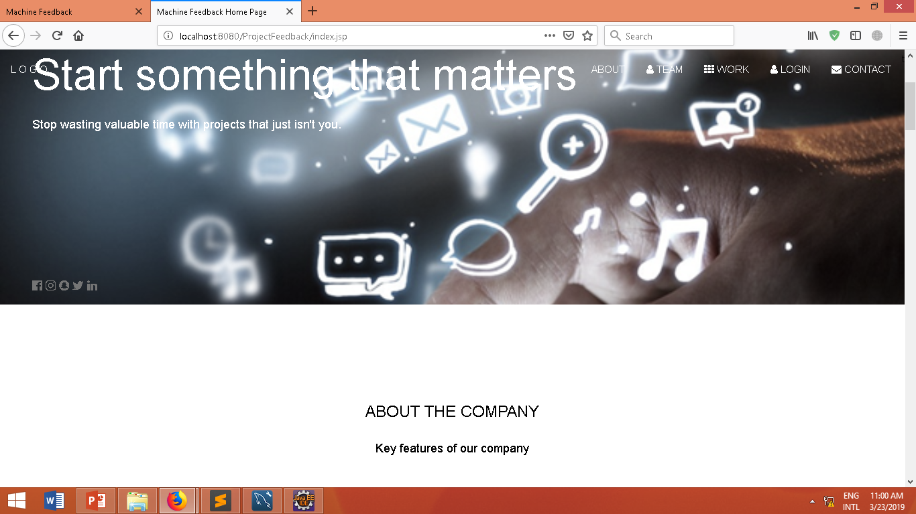
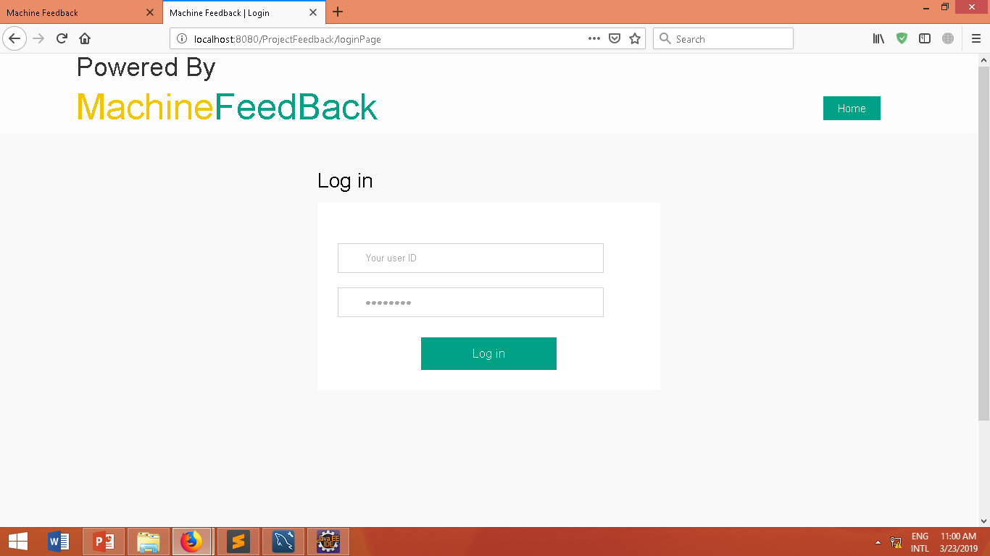
Experimental analysis and presentation of result
Home Page
Login Page

Slide 8
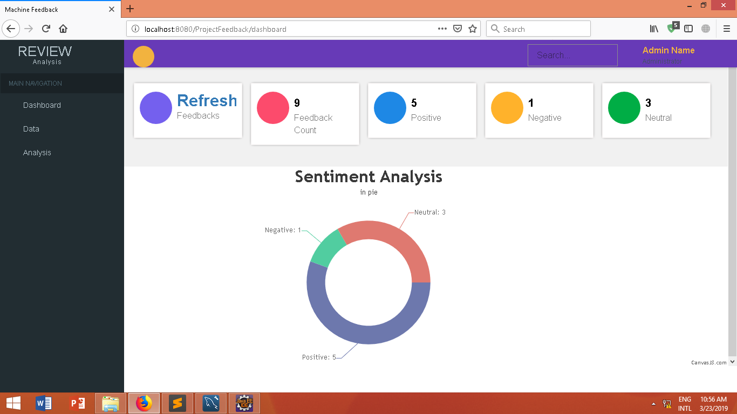
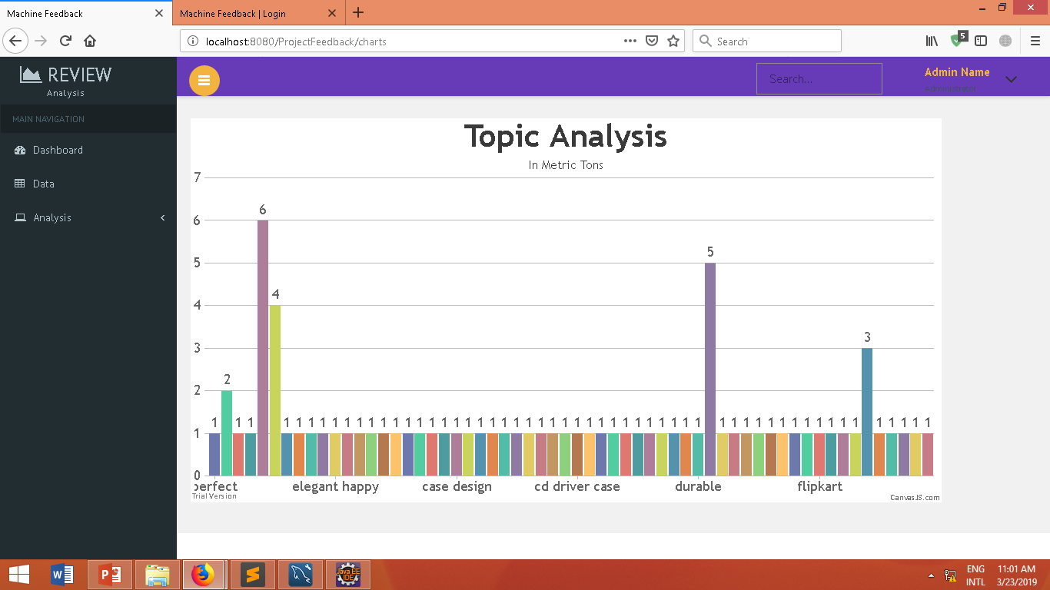
Dashboard
Topic Modeling Output

Slide 9

Future work
The topic modelling model will be improved in order to obtain better accuracy and specialization over a particular domain.

Slide 10

References
https://developer.android.com/
https://github.com/mozilla/DeepSpeech
https://stanfordnlp.github.io/CoreNLP/
https://spring.io/projects/spring-ws
Dataset- http://en.wikipedia.org/wiki/List_of_blogs

Slide 11
Thank You

